Slide 1
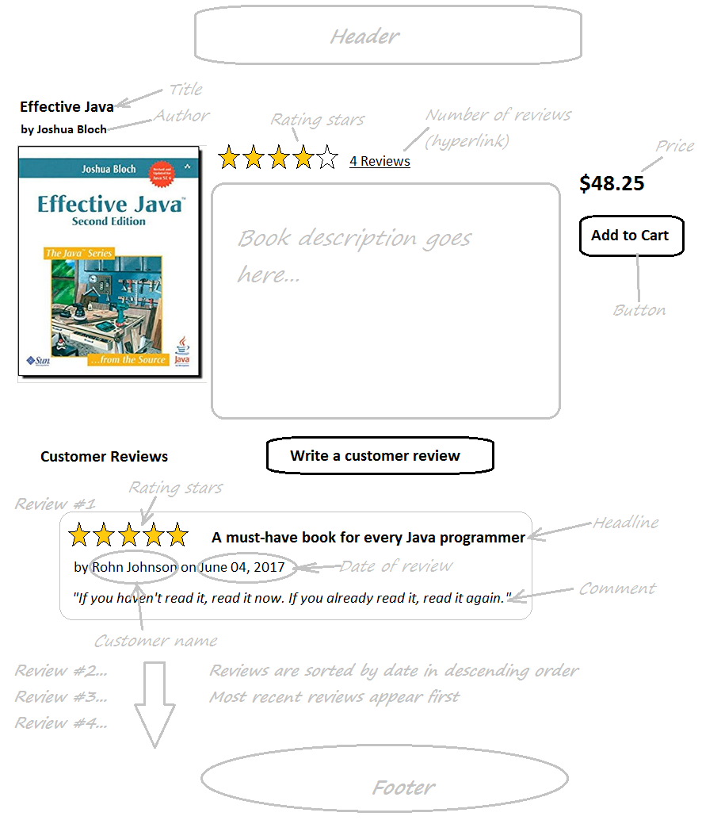
Implement View Book Detail Feature

Slide 2
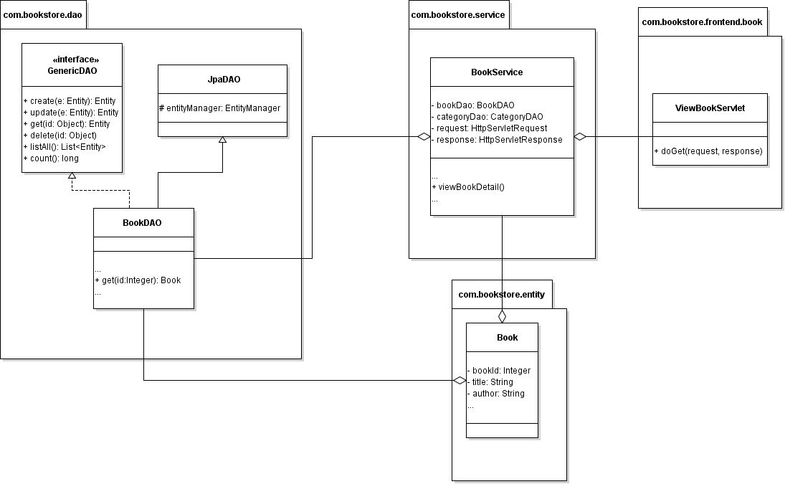
Class Diagram

Slide 3
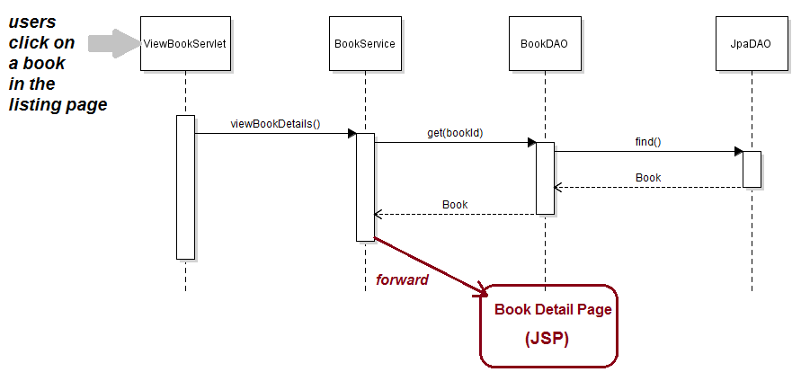
Sequence Diagram

Slide 4
Implement List New Books in Home Page
Task List:
Implement get() method in BookDAO + Write Unit test
Create ViewBookServlet
Update BookServices
Create Book Detail Page (JSP)

